Slide 1
Action +
Facilitators’ report
3rd October, 2025
Naxos, Greece
Aikaterini Aloupi
Eleftheria Axioti

Slide 2
Contents
01.
Introduction
02.
Workshop 1
Workshop Details
Participants
Workshop Structure and Methods
03.
Workshop 2
04.
Conclusions
Workshop Details
Participants
Workshop Structure and Methods

Slide 3
Workshop 1

Slide 4

Multi-thematic Conference
AGENDA OUTLINE
AGENDA OUTLINE
Title: Workshop 1 Action+
(Good Governance in Sports – Code of Action & Programme) Date: May 13, 2025 Time: 17.00 PM Venue: Conference Room
Jacqueline de Romilly,
Ministry of Education,
Religious Affairs and Sports Facilitators: Aikaterini Aloupi, Eleftheria Axioti

Slide 5
28
Participants
Federations
68

Slide 6
01.
02.
Introduction to governance
Poor governance
Contents
W1
03.
04.
European Convergent Code of Good
Governance
Content of Code
05.
06.
Effective code implementation
From theory to
practice

Slide 7

Photo Material

Slide 8

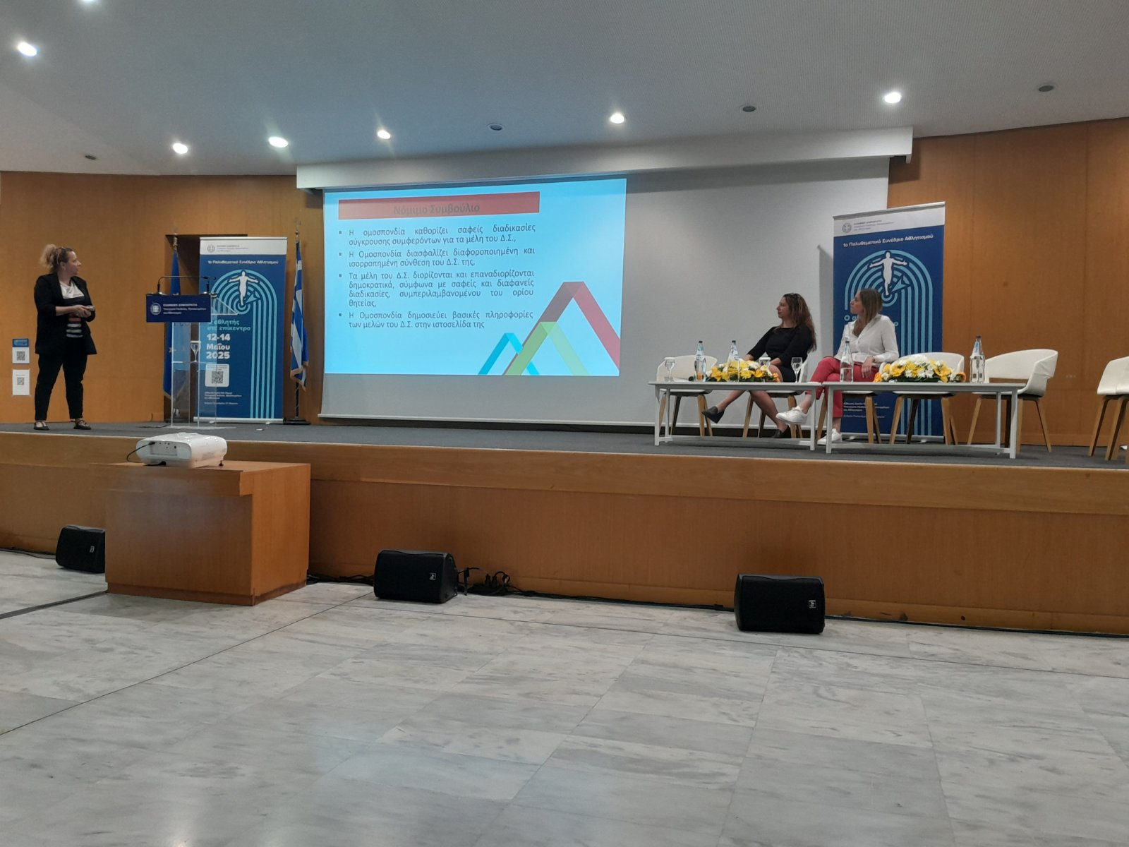
Photo Material

Slide 9
Photo Material

Slide 10
Photo Material

Slide 11
Workshop 2

Slide 12


Title text block &
Mobile project
AGENDA OUTLINE
Title: Workshop 2 Action+
(Good Governance in Sports – Code of Action & Programme) Date: July 30, 2025 Time: 10:30 AM – 15:00 PM Venue: Conference Room
Jacqueline de Romilly,
Ministry of Education,
Religious Affairs and Sports Facilitators: Aikaterini Aloupi, Eleftheria Axioti

Slide 13
22
Federations
Representatives
18

Slide 14




Workshop structure
Session 1
Session 2
Session 3
Session 4
Introduction
European programme Action and Action+
What is Good Governance in Sport?
Principles from the European Converged Code
Case Study – Example of a
Greek Federation at Risk
Tools for Identifying Gaps
(SWOT, Self-assessment questionnaire)
Poll – Participants use a self
-assessment tool via mentimeter
based on the converged code
and good governance in sports to
score their organizations
Interactive discussion
Small working groups: Sharing good practices – short presentations.

Slide 15
1st Tool
ΔΥΝΑΤΑ ΣΗΜΕΙΑ (STRENGTHS)
ΑΔΥΝΑΜΙΕΣ (WEAKNESSES)
.
Ισχυρή ιστορική παρουσία και
αναγνωρισιμότητα στον χώρο του
αθλητισμού
Ισχυρό δίκτυο μελών ή σωματείων
Στελέχη με εμπειρία ή ισχυρές
διασυνδέσεις σε θεσμικό/πολιτικό
επίπεδο.
Έλλειψη στρατηγικού σχεδιασμού και αξιολόγησης.
Αδυναμία προσέλκυσης χορηγών ή
χρηματοδοτήσεων λόγω χαμηλής
αξιοπιστίας.
S
W
O
T
ΕΥΚΑΙΡΙΕΣ (OPORTUNITIES)
ΑΠΕΙΛΕΣ (THREATS)
Πίεση από πολιτεία ή διεθνείς οργανισμουςγια εφαρμογή χρηστής διακυβέρνησης .
Επιβολή κυρώσεων
Πρόβλημα με την χρηματοδότηση
Νομικές επιπτώσεις
Αποκλεισμοί

Slide 16

2nd Tool
.
Self Assessment Tool

Slide 17



Poll
self-assessment tool via mentimeter

Slide 18
Level of Governance

Slide 19
Biggest Threat

Slide 20
Suggestions

Slide 21
Working Groups

Slide 22
Photo Material

Slide 23
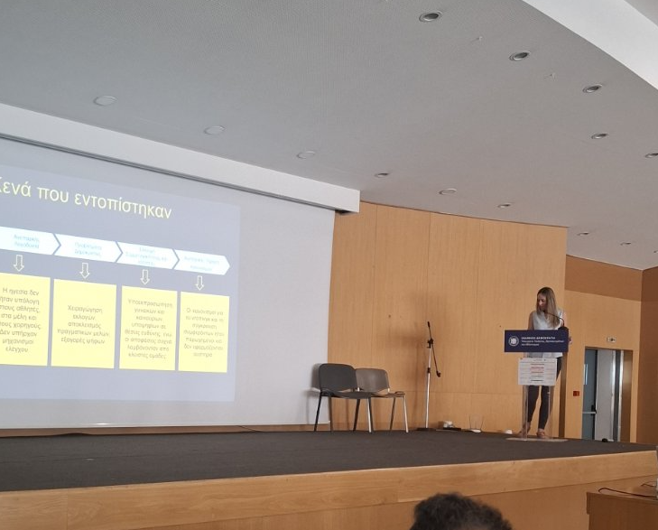
Photo Material

Slide 24
Photo Material

Slide 25
Photo Material

Slide 26
Main Outcomes and Highlights

Slide 27


Main learning points reached
Understand the structure and the principles of European Convergent Code of Good Governance in Sports
Learn how to set realistic objectives and prioritize actions
Identify key areas for improvement within their own organization using the Code as a benchmark
Share best practices for good governance
Topics for generated discussion
Establishment of clear conflict of interest procedures for the members of the Board.
Sponsorship transparency
Lack of qualified or specialized staff
Insufficient funding to support payroll and the engagement of expert collaborators, including sports psychologist, safeguarding officer, and chartered accountant

Slide 28
Thank you!

